Slide 1

GENERALIZATION AND
THE KNN ALGORITHM
CARLOS FERRO

Slide 2
Classification and Regression
Classification
Goal: To predict a class label
– Class label: A choice from a predefined list of possibilities
Binary Classification: Exactly two classes (yes/no question)
Multiclass Classification:
Classification among more than two classes (Iris example)
Regression
Goal: To predict a continuous number (floating-point)
Examples:
Person’s annual income from their education, age, and where they live
Yield of a corn farm given previous yields, weather, number of employes

Slide 3
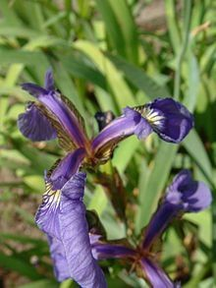
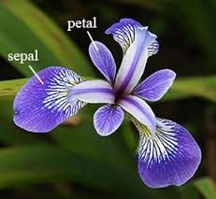
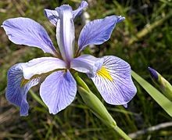
A first application: Classifying Iris Species
Example taken from Introduction to machine learning with Python by Andreas Muller
Task: Distinguishing the species of some iris flowers (setosa, versicolor, or virginica)

Slide 4
A first application: Classifying Iris Species
Data: Measurements associated with each iris:
Length and width of the petals
Length and width of the sepals
Some have been identified: setosa, versicolor, or virginica
Data scientist goal: To build a machine learning model that:
can learn from the measurements of the irises whose species is known,
So that we can predict the species for a new iris

Slide 5
Classifying Iris Species: Type of ML task
We have measurements for which we know the correct species of iris:
We want to predict one of several options OR classes:
a three-class problem
For a particular data point (a flower) or
the species it belongs to is called its
the set of values that describe it is called its
(sepal length, sepal width, petal length, petal width)
– a supervised learning problem
classification
sample,
label
features

Slide 6
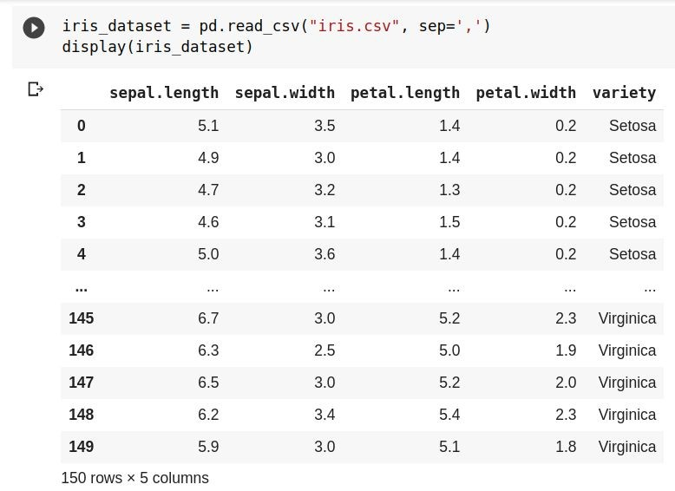
Load the data

Slide 7
Data exploration
Inspect the data before building the model!
Abnormalities and peculiarities
Do we need machine learning?
Is the data good enough?
Visualise the data
scatter plot (2D)
pair plots: scatter_matrix

Slide 8
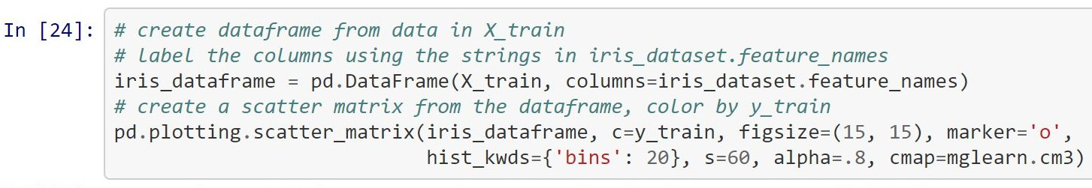
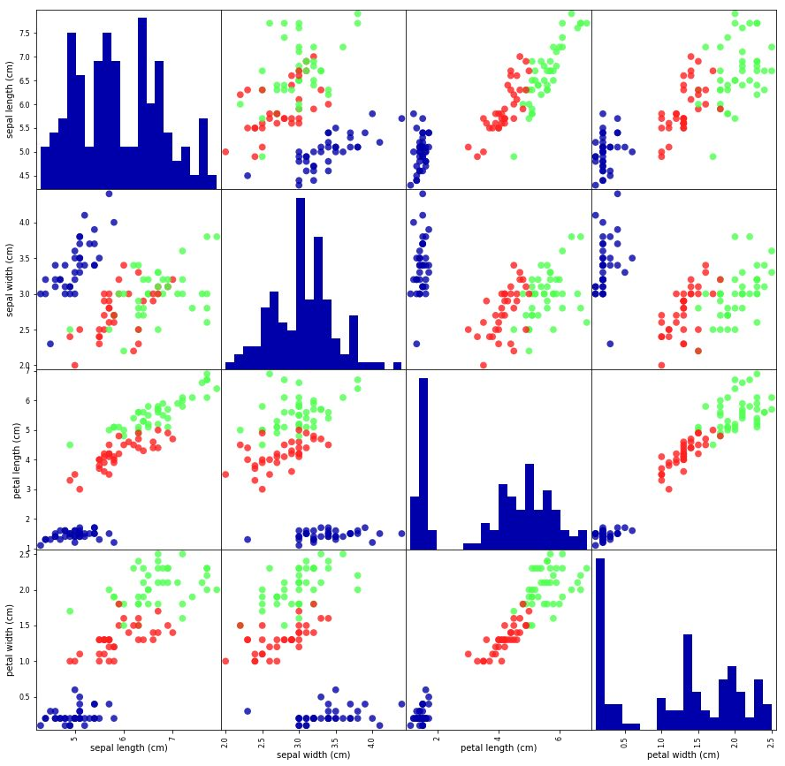
Look at your data

Slide 9
Measuring performance: training and testing data
Aim: To build a machine learning model from data that can predict the species of iris for a new set of measurements.
Will our model generalize well? How to evaluate its
performance?
we cannot use the data we used to build the model!
we show it new data for which we have labels
Split the labelled data:
training data or training set
test data or test set

Slide 10
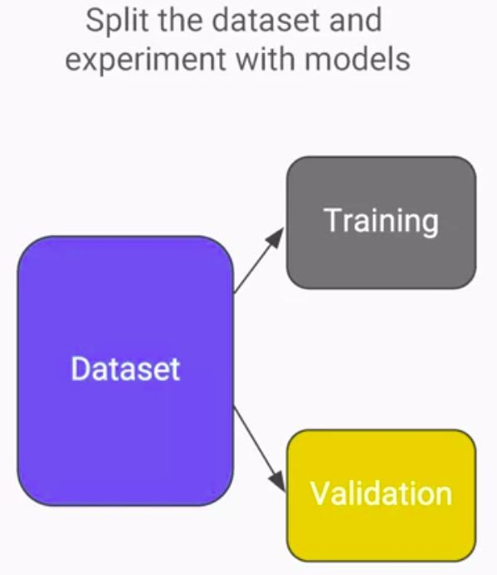
Performance of a ML model
The only measure of whether an algorithm will perform well on new data is the evaluation on the validation set
We expect simple models to generalise better

Slide 11
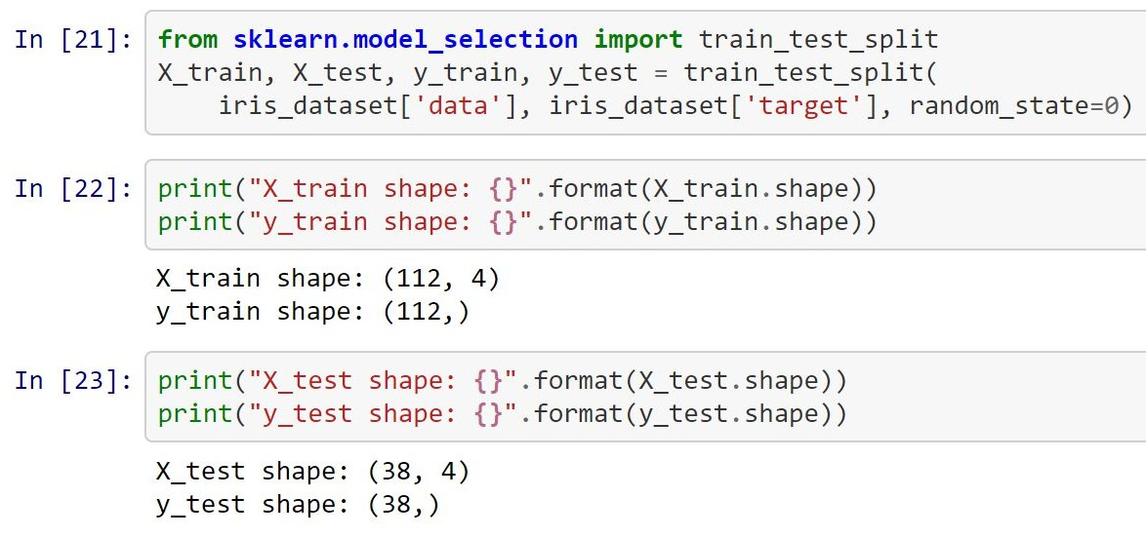
Training and testing data

Slide 12
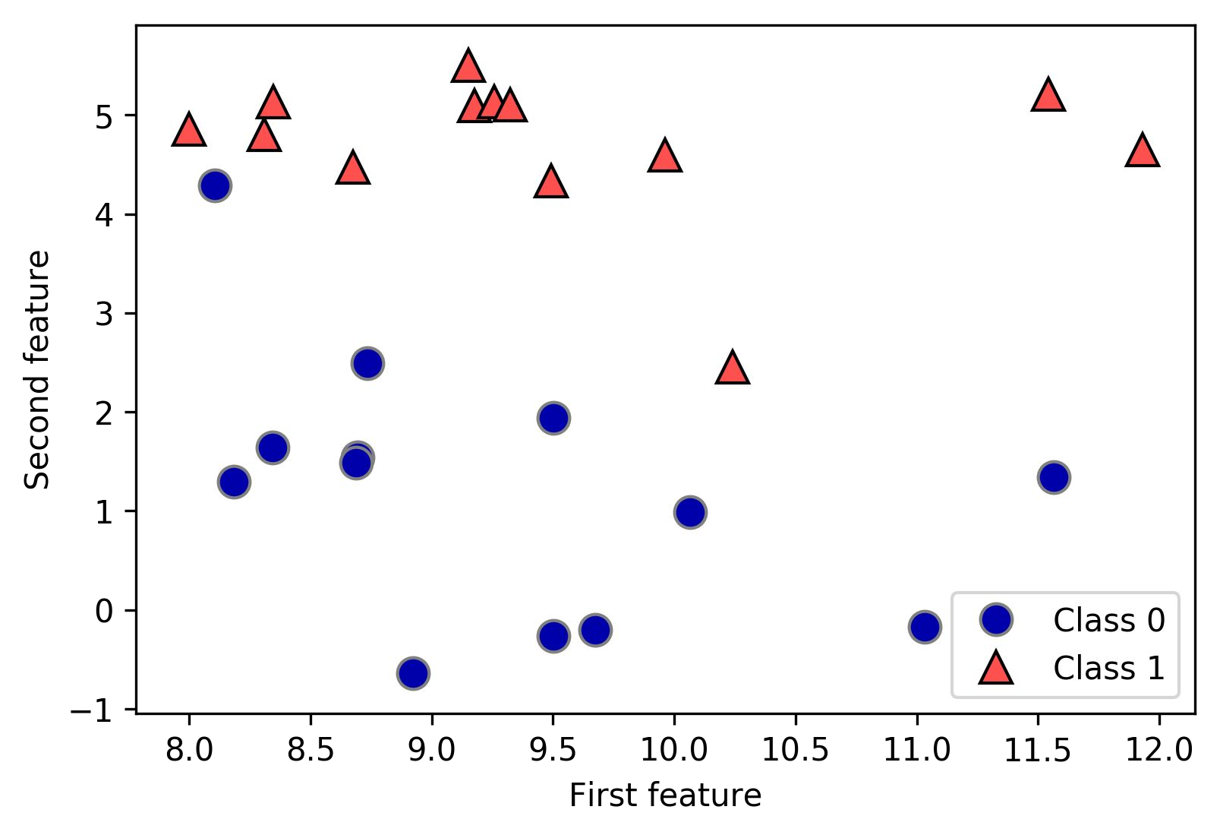
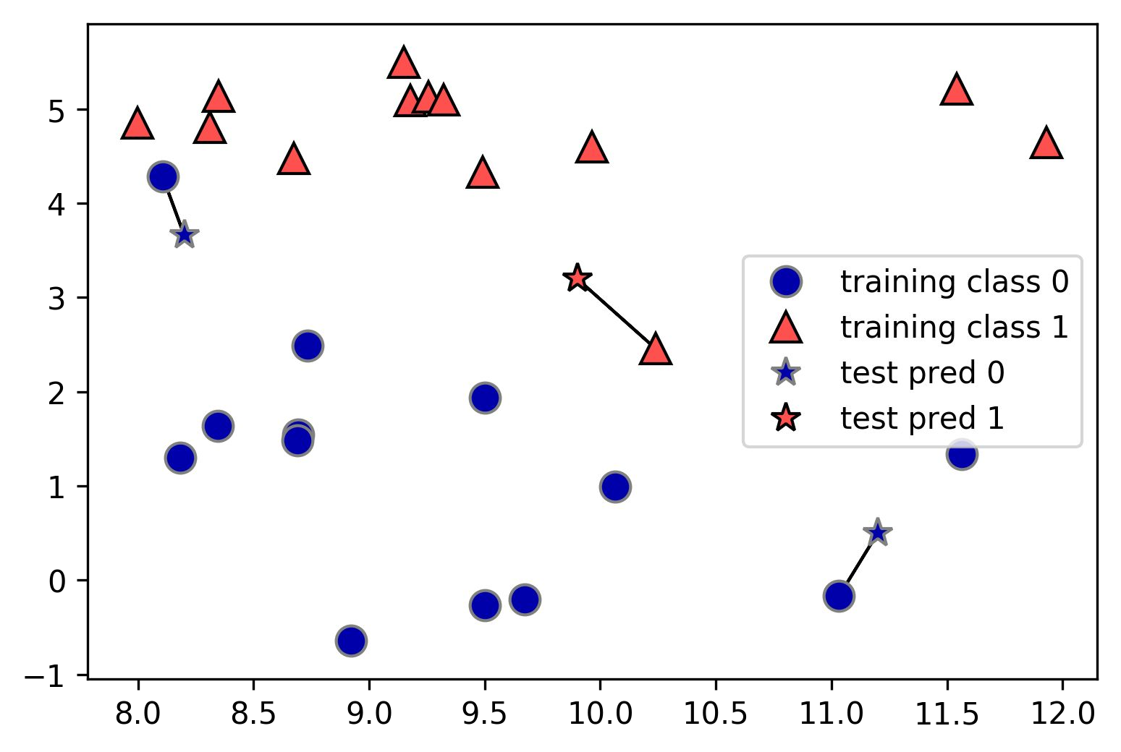
The k-Nearest Neighbors (k-NN) algorithm
The simplest machine learning algorithm
Training (Build the model):
Storing the training dataset
Inference (Make a prediction): Find the closest data points in the training dataset
Simplest version: One nearest neighbor.

Slide 13
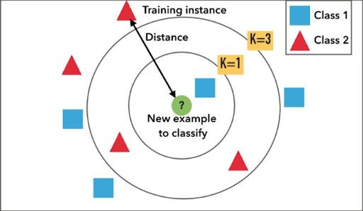
k-Neighbors classification
When considering more than one neighbor, we use
voting to assign a label
For each test point, we count how many neighbors belong to class 0 and class 1
We assign the class that is more frequent

Slide 14
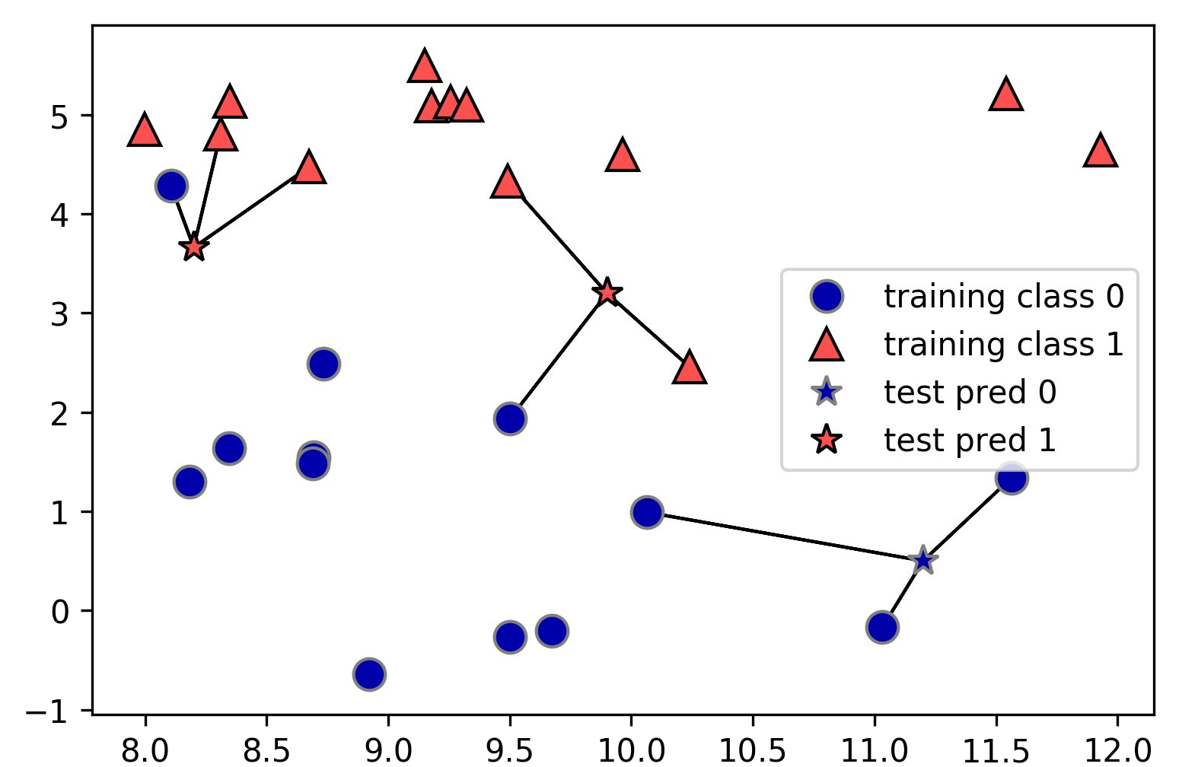
3-Neighbors classification

Slide 15
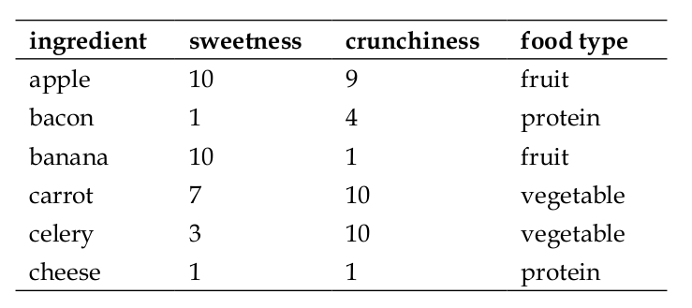

Slide 16
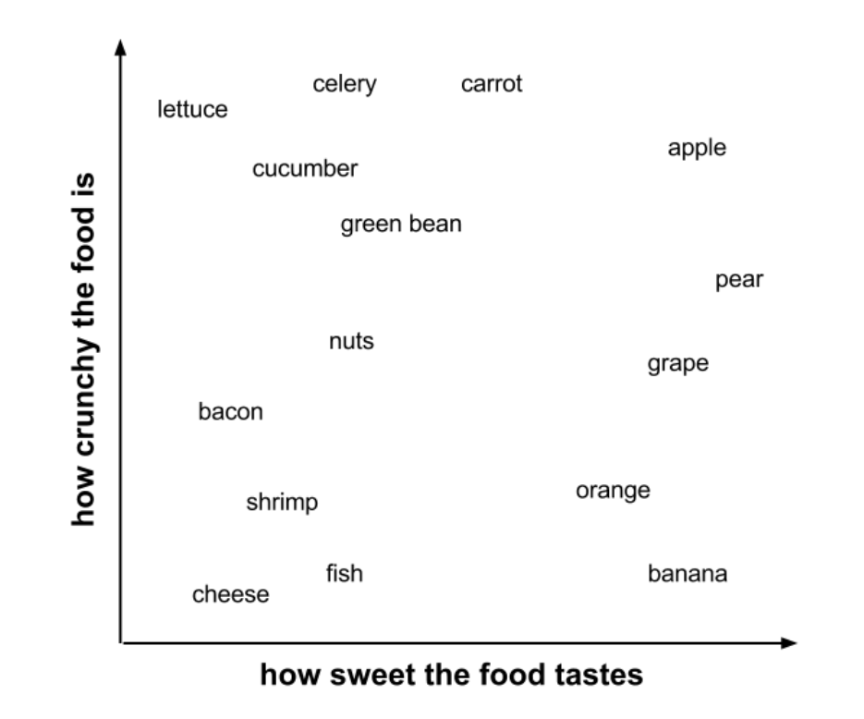

Slide 17
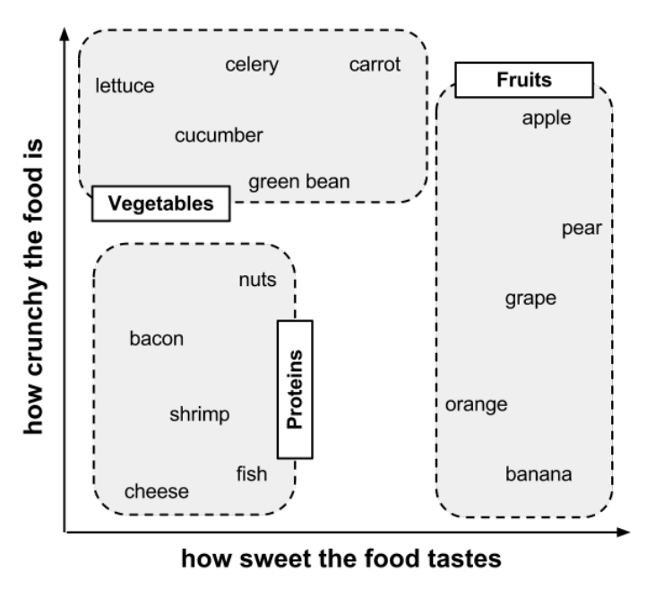

Slide 18
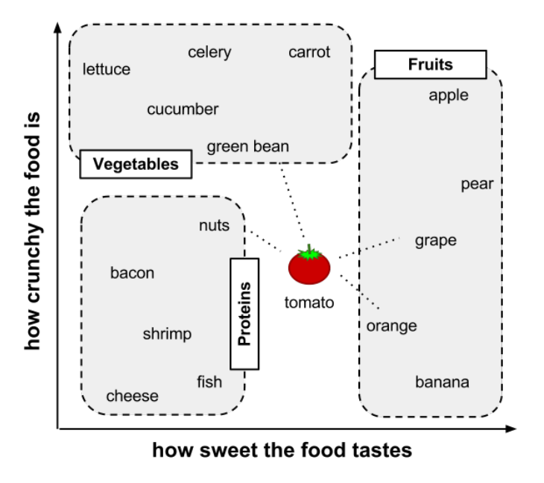

Slide 19
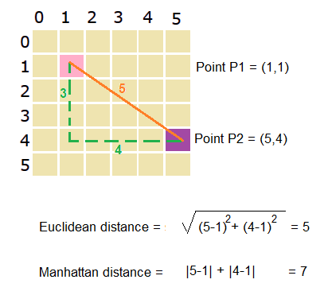
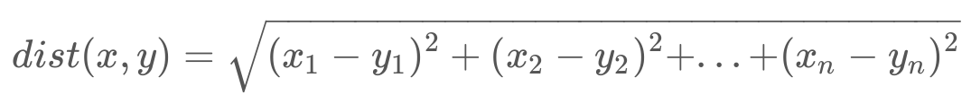
Distancia Euclidiana
Distancia Manhattan

Slide 20
Característica | Distancia Euclidiana | Distancia Manhattan
Tipo de camino | Línea recta | Camino en ángulos rectos (rejilla)
También llamada | L2 norm | L1 norm
Sensibilidad | Más sensible a valores extremos | Más robusta frente a outliers
Geometría | Esferas (círculos en 2D) | Diamantes (rombos en 2D)
Usos comunes | Espacios continuos, clustering (K-Means) | Espacios discretos, regresión Lasso, KNN L1

Slide 21
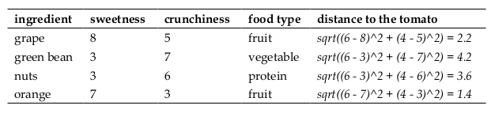
Tomate (sweetness = 6, crunchiness = 4)

Slide 22
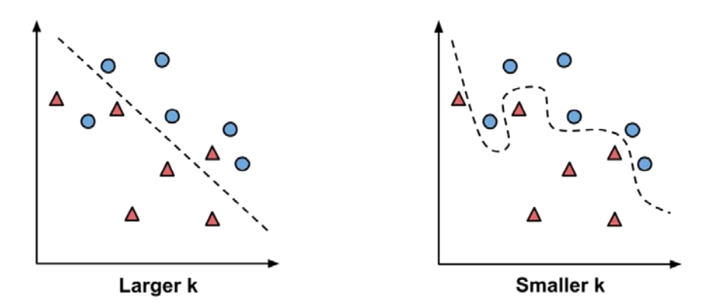

Slide 23
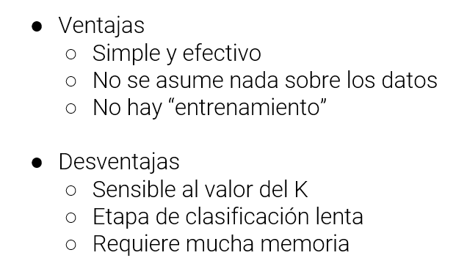

Slide 24
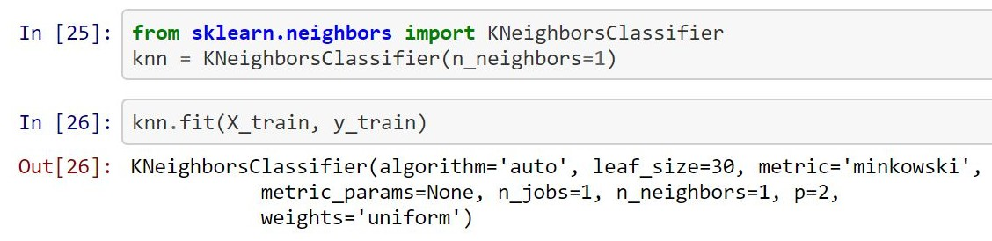
Building your first model: k nearest neighbors

Slide 25
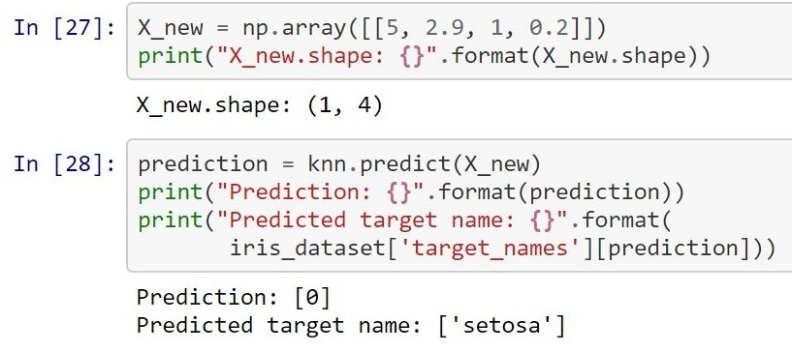
Making predictions

Slide 26
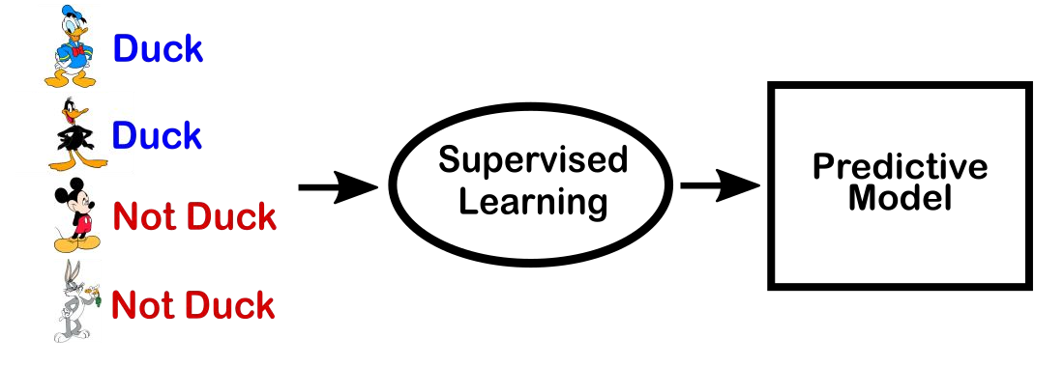
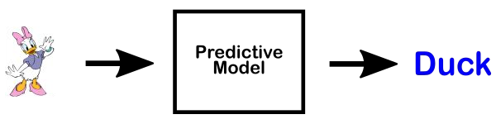
Performance of a ML model: Generalisation
If the model is able to make accurate predictions on unseen data, we say it is able to generalize from the training set to the test set
If we build very complex models, we can always be as accurate as we like on the training set … but... is this useful?

Slide 27
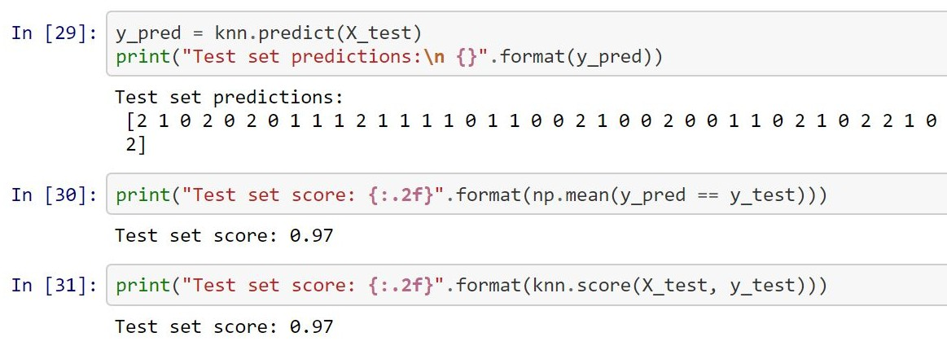
Evaluating the model

Slide 28
Performance of a ML model: Overfitting
We always want to find the simplest model!
Overfitting: Building a model that is too complex for the amount of information we have
Occurs when:
Fit a model too closely to the particularities of the training set
Obtain a model that works well on the training set but is not able to generalise to new data

Slide 29
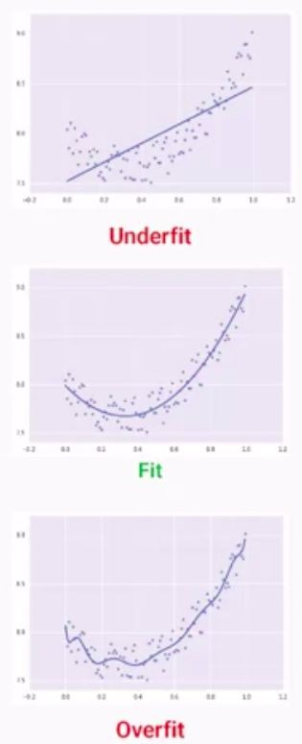
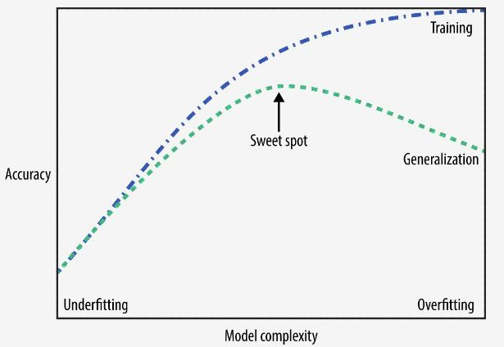
Performance of a ML model: Underfitting
Unable to capture all the aspects of and variability in the data: Model will do badly even on the training set!
The model is too simple
The model complexity trade-off

Slide 30
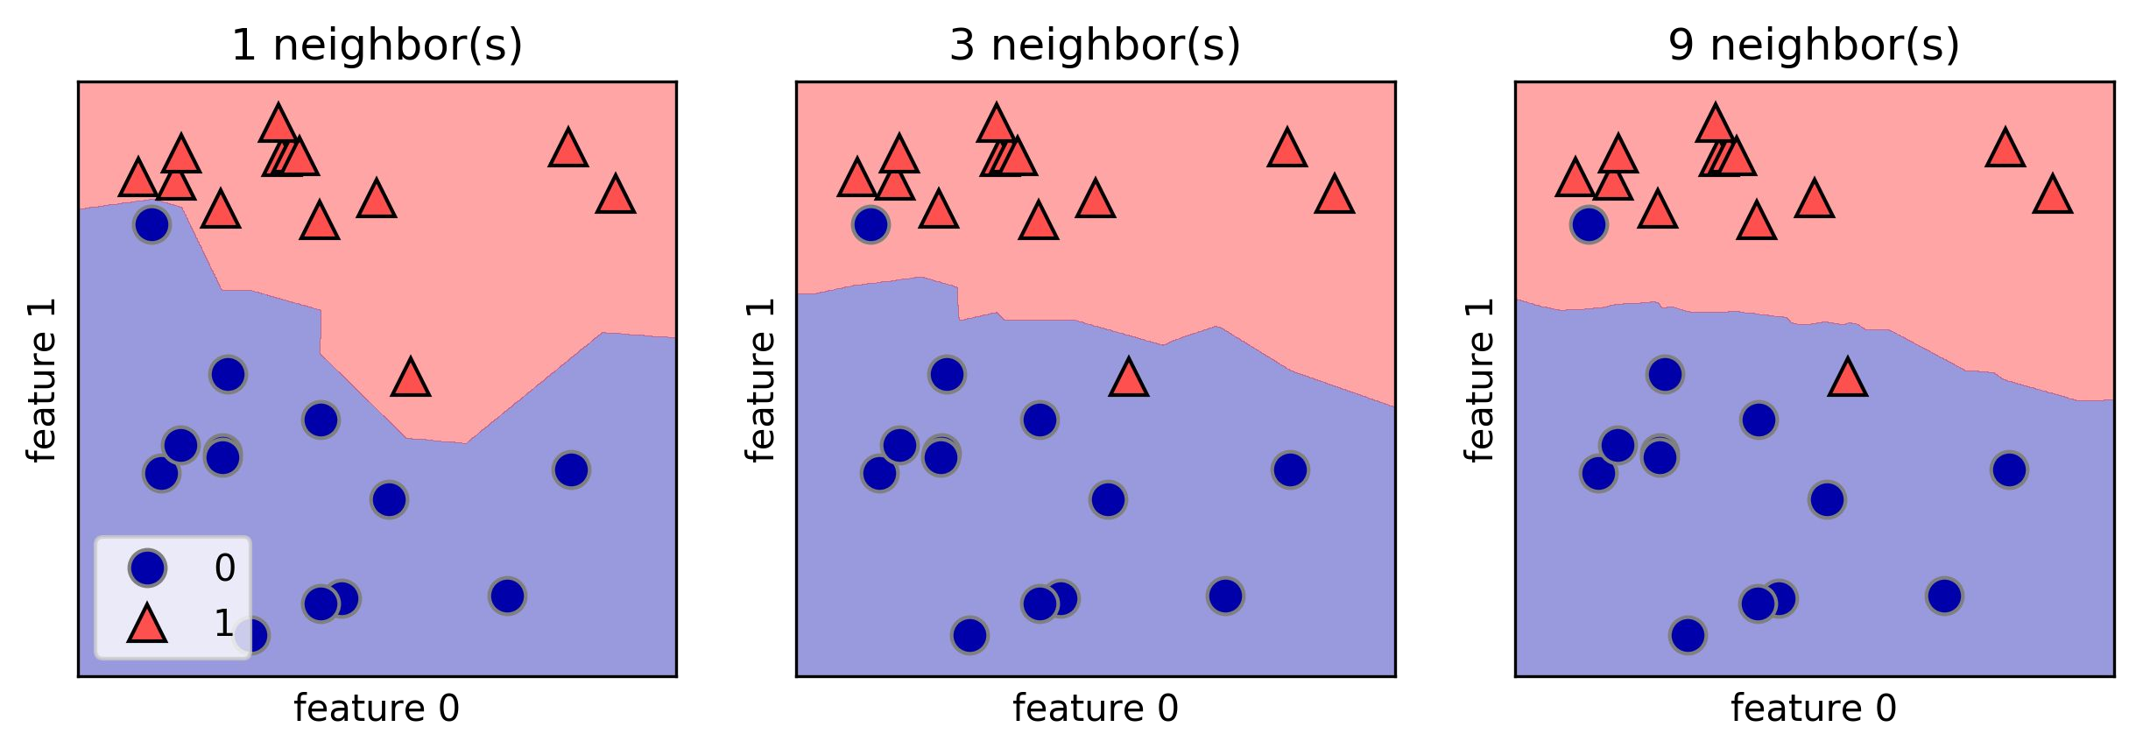
Analysing KNeighborsClassifier
For 2D datasets, we can illustrate the prediction for all possible test points in the xy-plane
This lets us view the decision boundary. which is the divide between where the algorithm assigns class 0 versus where it assigns class 1
A Smoother boundary corresponds to a simpler model!

Slide 31
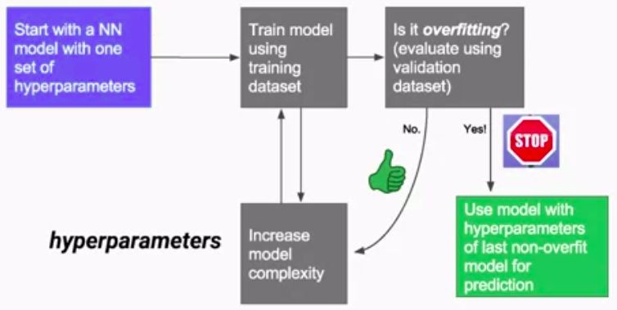

Slide 32
Relation of model complexity to dataset size
The larger variety of data points your dataset contains, the more complex a model you can use without overfitting
Collecting more data helps
Having more data and building appropriately more complex models can often work wonders for SL tasks
Never underestimate the power of more data!

Slide 33
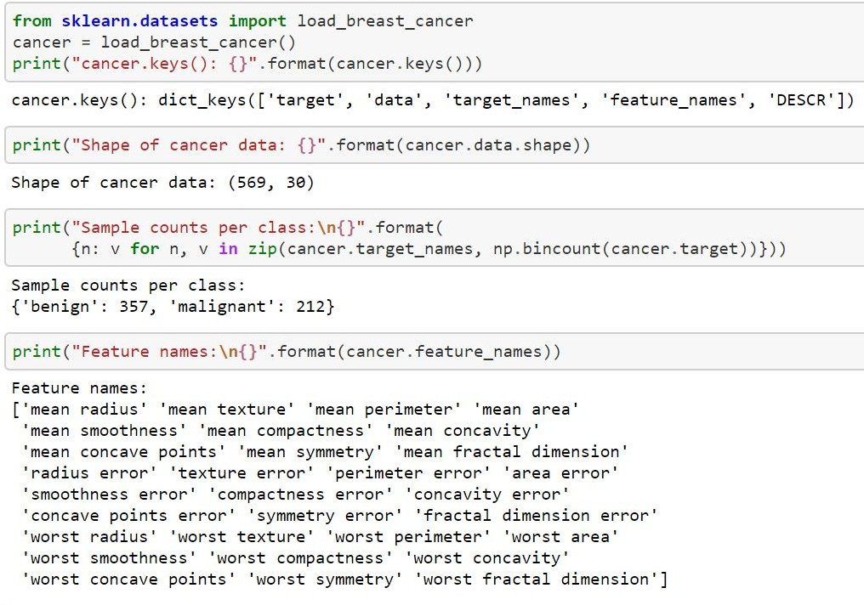
The Wisconsin breast cancer dataset
Real-world, included in scikit-learn
Clinical measurements of breast cancer tumors
“benign” (harmless tumors)/ “malignant” (cancerous tumors)
Task: Learn to predict whether a tumor is malignant based on the measurements of the tissue
569 data points (samples) with 30 features each

Slide 34
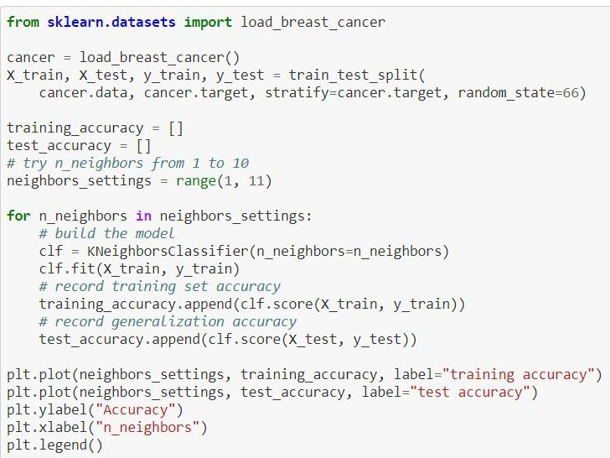
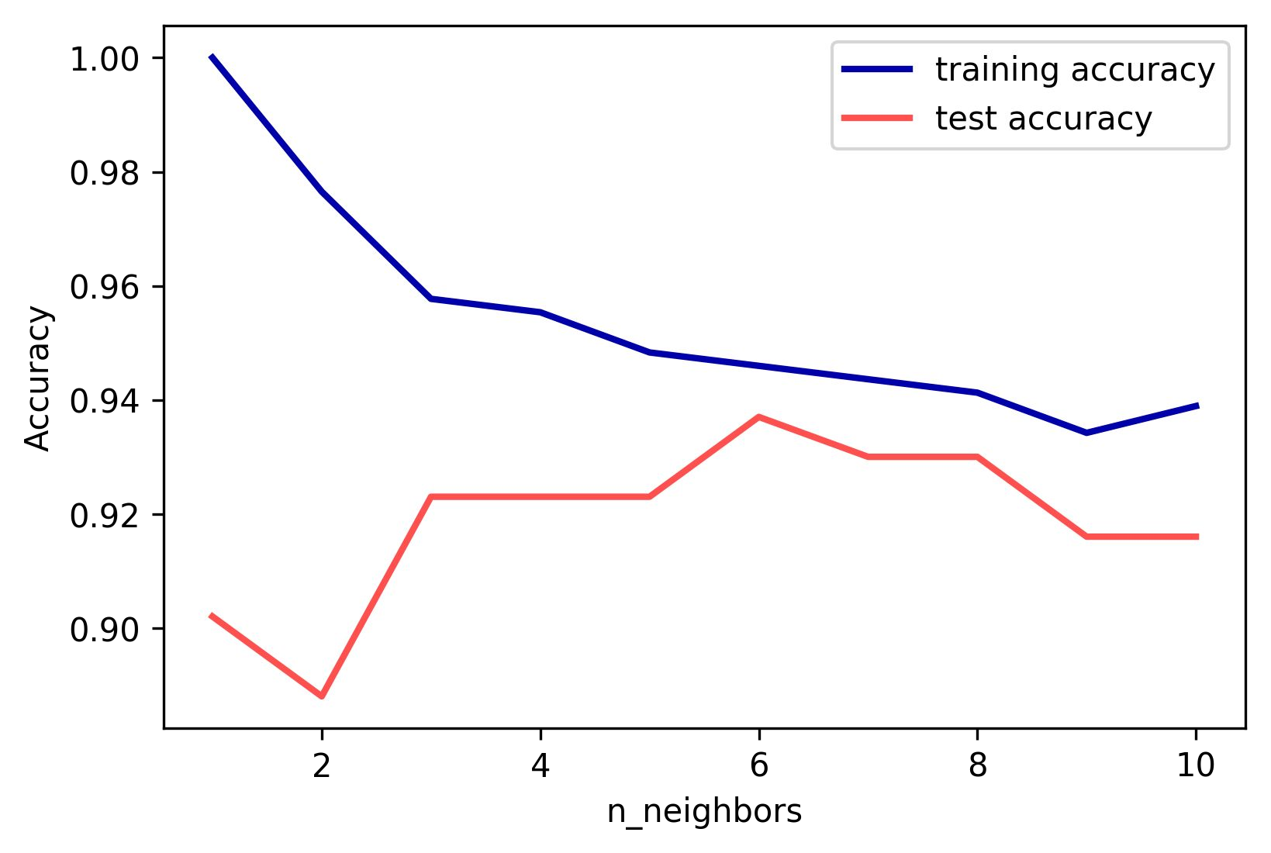
Analysing KNeighborsClassifier

Slide 35
Other performance metrics

Slide 36
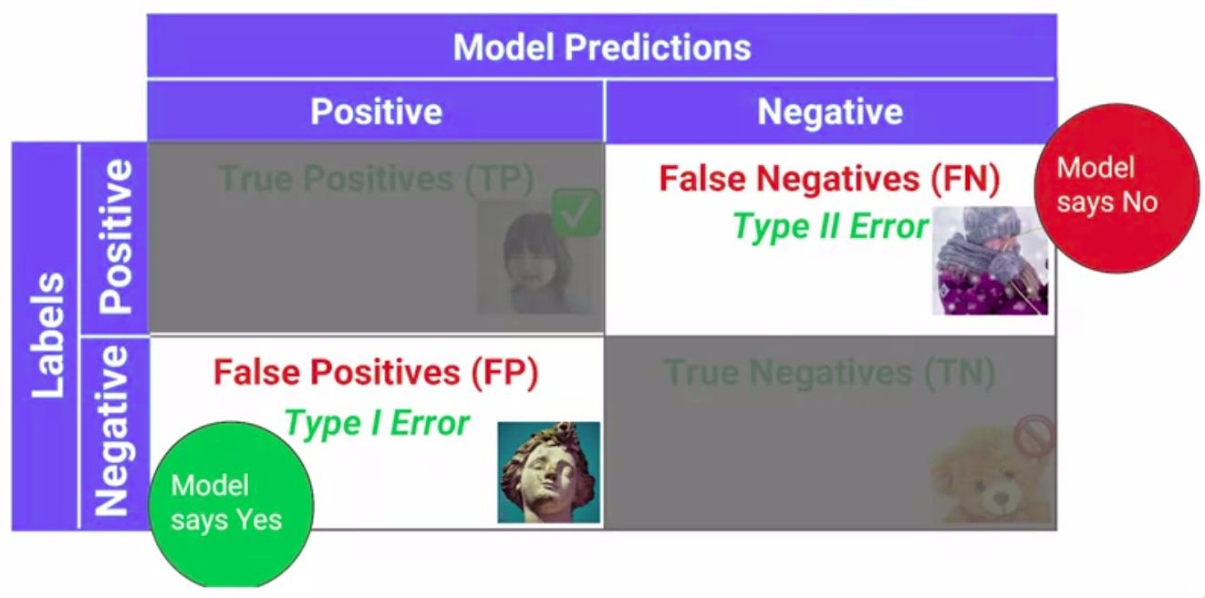
Confusion Matrix

Slide 37
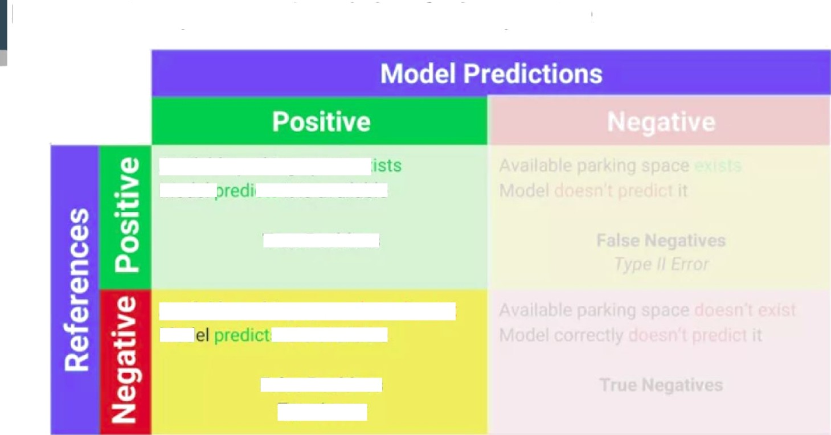
Precision: ti ue positives / total Classified as positive
Available parking space- ›. Model . il is available
True Positives
Available parking space doesn't exisi Mod s it is available
False Positives
Type I error
Precision

Slide 38
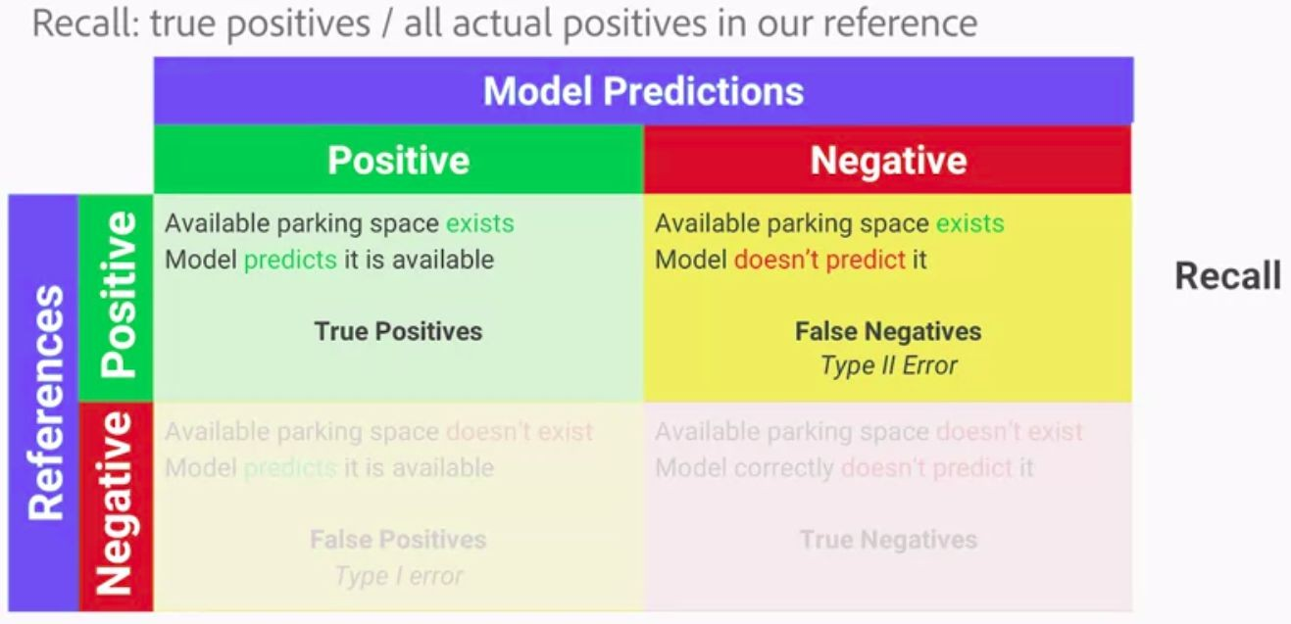

Slide 39
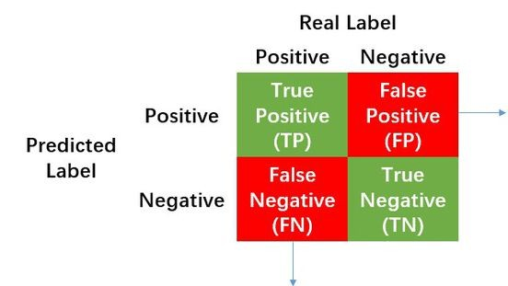
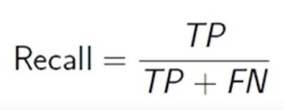
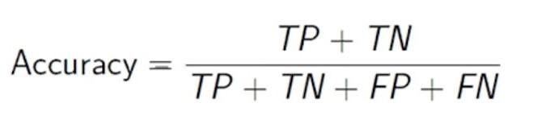
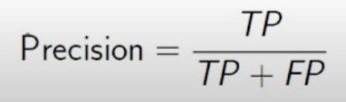
Source:
https://www.researchgate.net/figure/Calculation-of-Precision-Recall-and-Accuracy-in-the-confusion-matrix_fig3_336402347

Slide 40
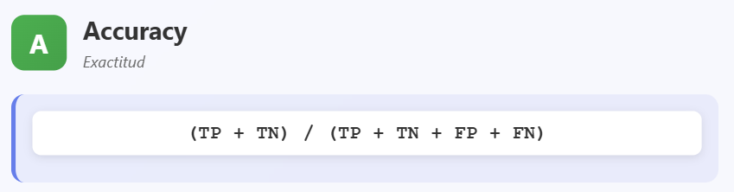
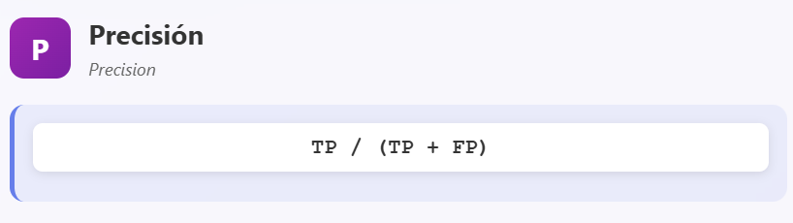
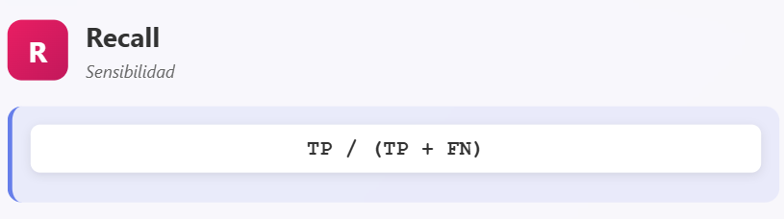
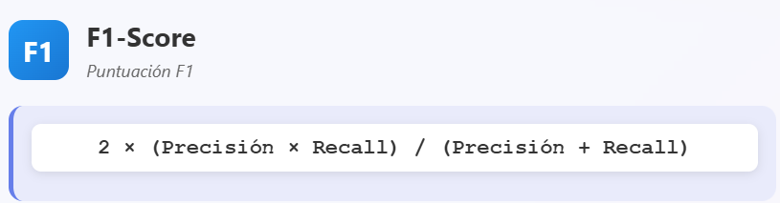
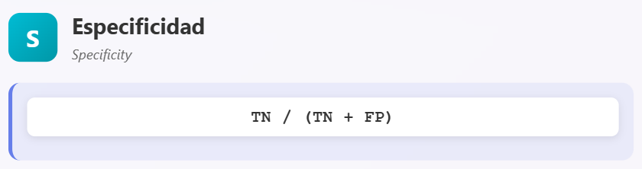
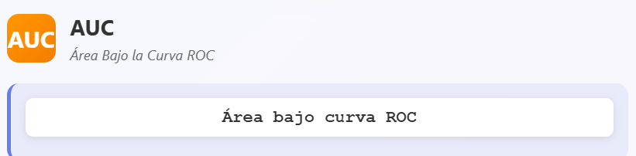

Mide desempeño global; puede ser engañosa con clases desbalanceadas.
Proporción total de predicciones correctas (positivas y negativas).
Proporción de verdaderos positivos entre todos los predichos como positivos.
Alta precisión = pocos falsos positivos.
Proporción de verdaderos positivos detectados entre todos los positivos reales.
Alto recall = pocos falsos negativos (buen detector).
Equilibra precisión y recall; útil en clases desbalanceadas.
Media armónica entre precisión y recall.
Proporción de verdaderos negativos correctamente identificados.
Alta especificidad = pocos falsos positivos (buena detección de negativos).
Cuanto más cerca de 1, mejor desempeño; 0.5 indica modelo aleatorio.

Slide 41
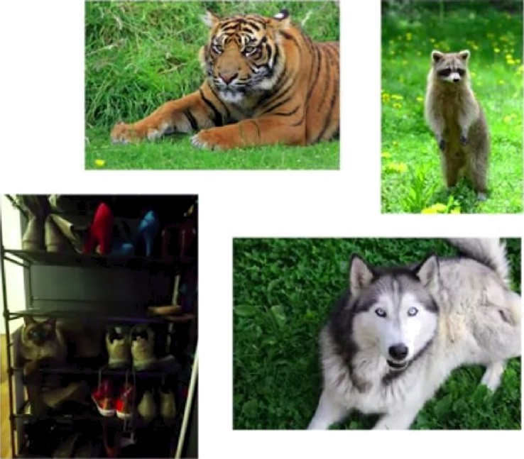
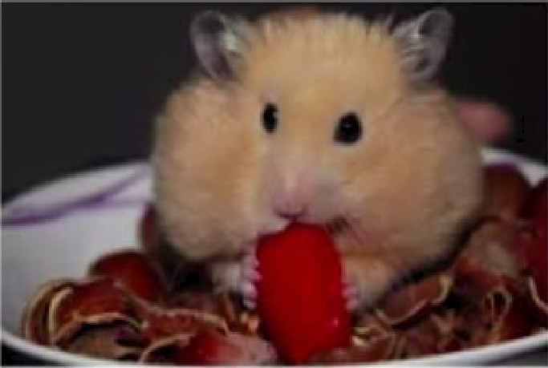
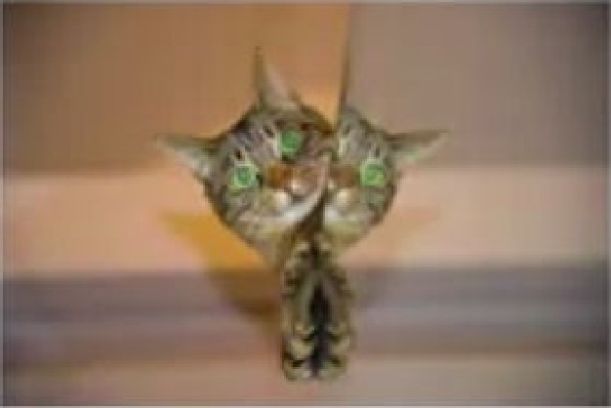
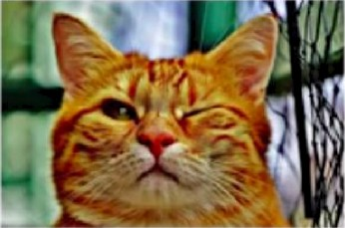

Your turn: classify each image below as either"cat" or"not cat"

Slide 42


Slide 43












Hypothetical results from our classification ML model
You: No Cët
No
cæ
Nb Nb
Cat

Slide 44








Hypothetical results from our classification ML model
6t
at
L:
Cat
Cat
Cat
Cat s@’.at

Slide 45




Quiz No\’/ precise ›x dS our ’cat
ML nzod«l*
Precision
TP / (TP + FP)
2 / 5 0 40

Slide 46


Quiz: Wha1 recall did our model have?
Recall = TP / (TP + FN)
= 2 / 4 = 0.50

Slide 47
Homework
Your First Machine Learning Model
https://www.kaggle.com/dansbecker/your-first-machine-learning-model?utm_me dium=email&utm_source=gamma&utm_campaign=thirty-days-of-ml&utm_conten t=day-9
Model Validation
https://www.kaggle.com/dansbecker/model-validation?utm_medium=email&utm
_source=gamma&utm_campaign=thirty-days-of-ml&utm_content=day-9
https://www.kaggle.com/dansbecker/underfitting-and-overfitting?utm_medium=e mail&utm_source=gamma&utm_campaign=thirty-days-of-ml&utm_content=day-1 0
Find python implementations of the performance metrics presented in class

